Slide 1
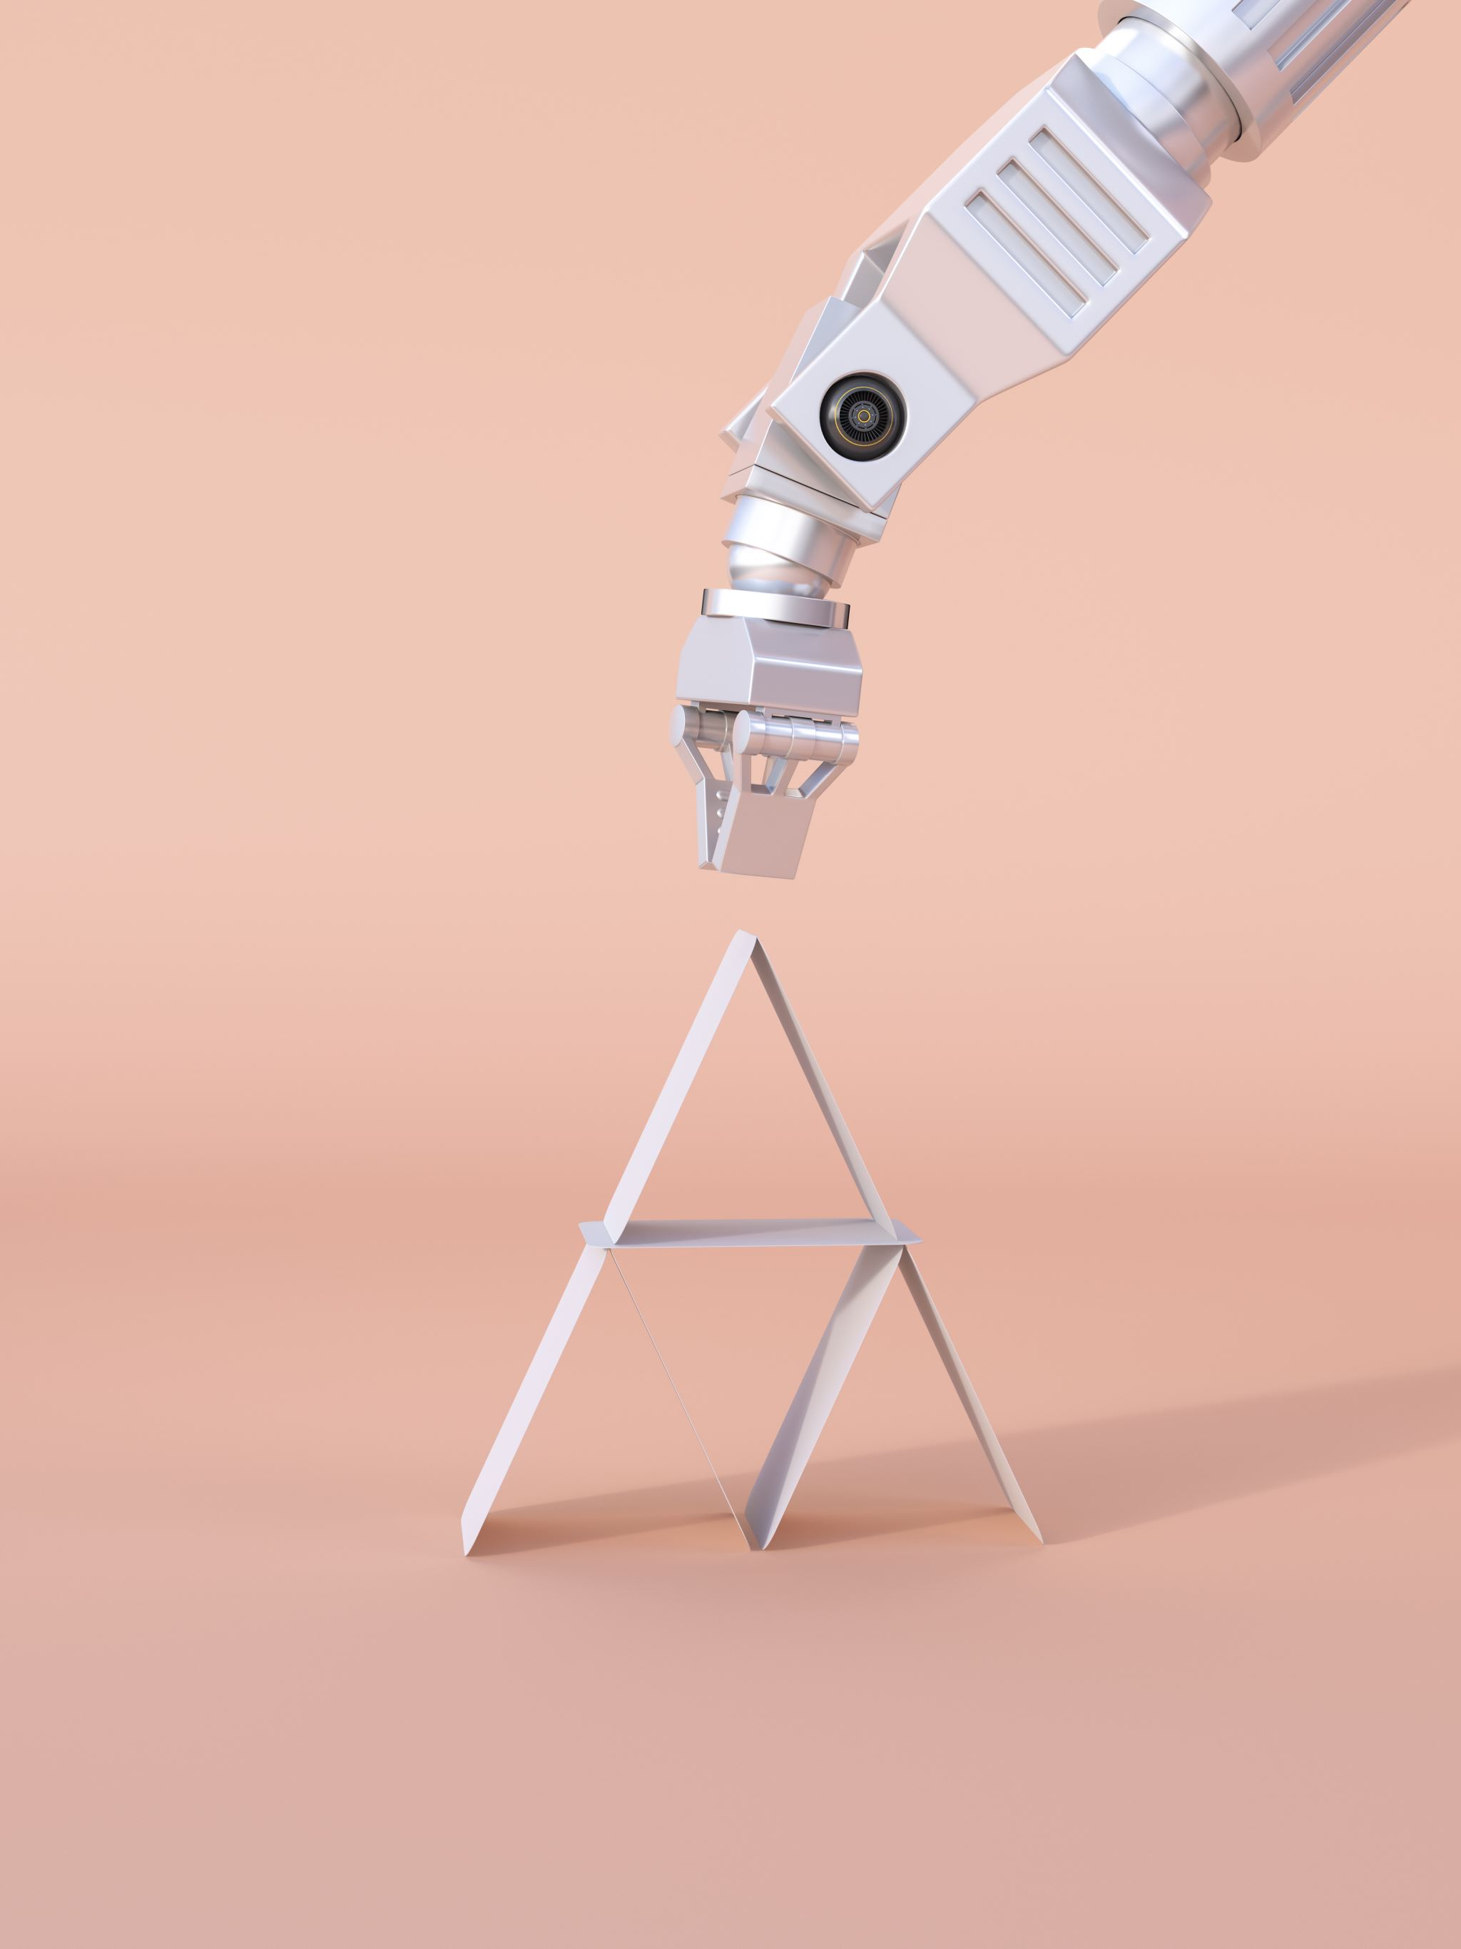
Robotic Arm Control with AI visión By: Aaron Lazo
Robotic Arm Control with AI visión By: Aaron Lazo

Slide 2
Objectives: 1- Prove the theoretical concepts of robotics. 2- Develop a structured solution for object manipulation. 3- Analyze the viability of low budget manipulators.
Objectives: 1- Prove the theoretical concepts of robotics. 2- Develop a structured solution for object manipulation. 3- Analyze the viability of low budget manipulators.

Slide 3
Robotics in the industry
Complex Solutions*
Robust
Expensive
In Academia
Open Source
Simplified
Low-Cost

Slide 4
How to Engineer a Robot?
What to manipulate?
Which Theoretical Concepts?
What materials?

Slide 5
What to manipulate?
What to manipulate?
Anything SOLID that can be gripped
In a planar Workspace
With a clear marker to identify
Anything SOLID that can be gripped
In a planar Workspace
With a clear marker to identify

Slide 6
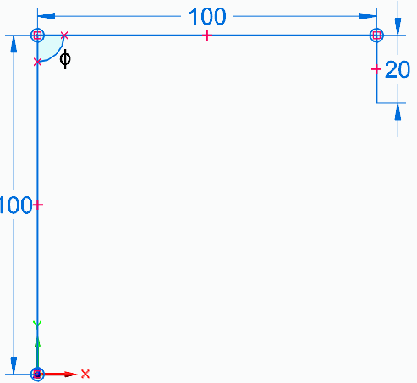

Basic RRR-Planar
$$\cos\left(φ\right)= \frac{X^{2}{+(Y+20)}^{2}− {L_{1}}^{2}−{L_{2}}^{2}}{2L_{1}L_{2}}$$
$${∗θ}_{2}=180±acos(φ)$$
$$θ_{1}=atan2\left(Y, X\right)−atan2(L_{2}sinθ_{2}, L_{2}cosθ_{2}+L_{1})$$
$$θ_{3}=θ_{123} −θ_{2} −θ_{2}$$
$$=−90−θ_{2} −θ_{2}$$

Slide 7
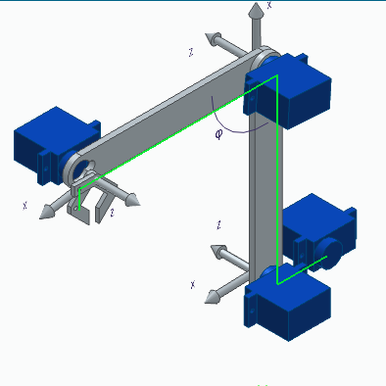
Shifting Angles and Controlling Velocity
Shifting Angles and Controlling Velocity
Rotation Direction must be compensated.
Relative zero is different in every motor
Velocity does not have feedback

Slide 8
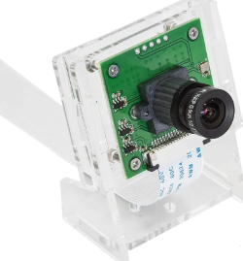
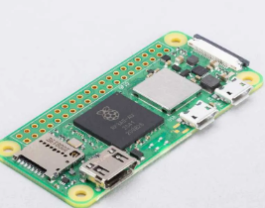
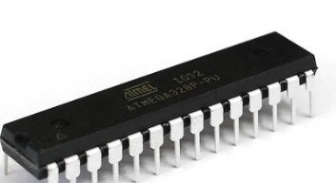
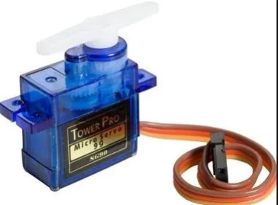
Which Components?
1- Micro-Servos
2- Mechanical
Strucure
3- Controllers
4- Camera

Slide 9
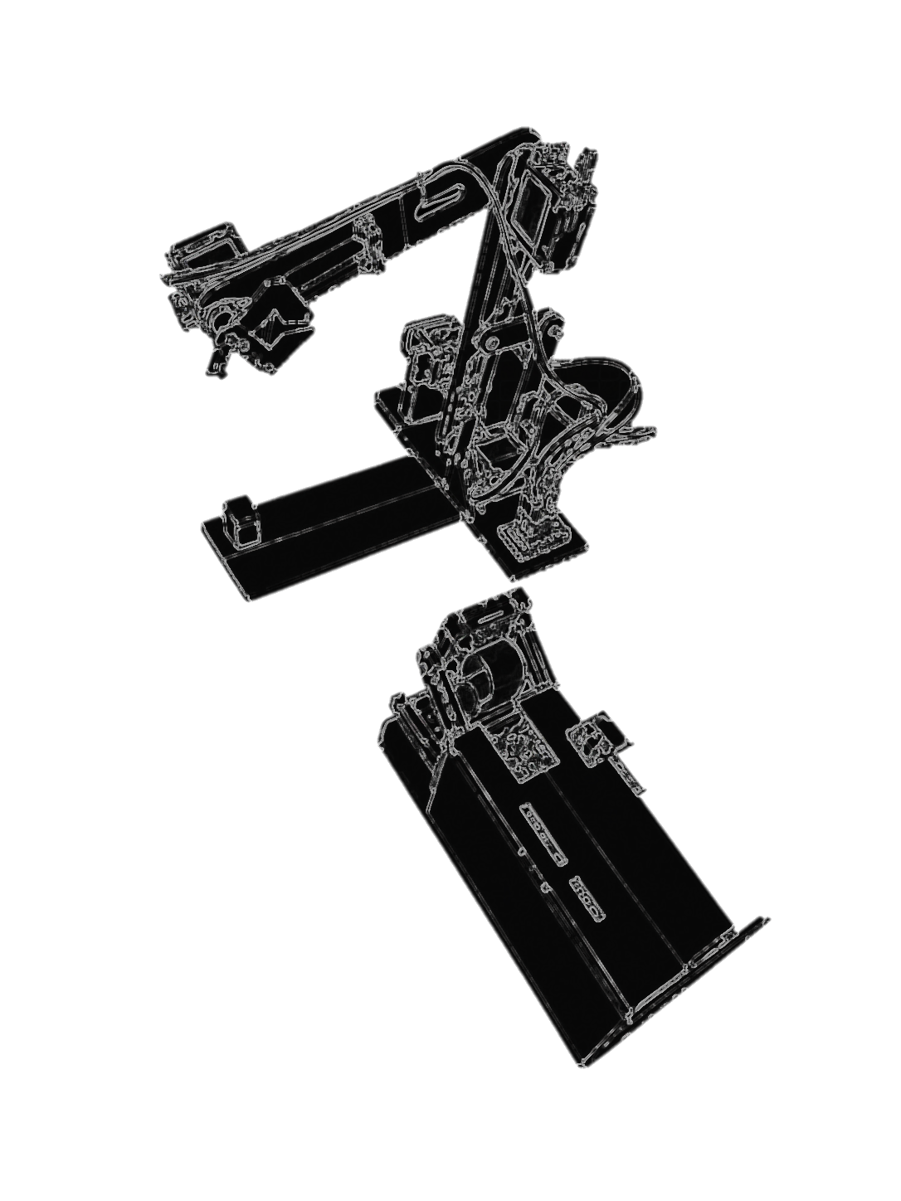
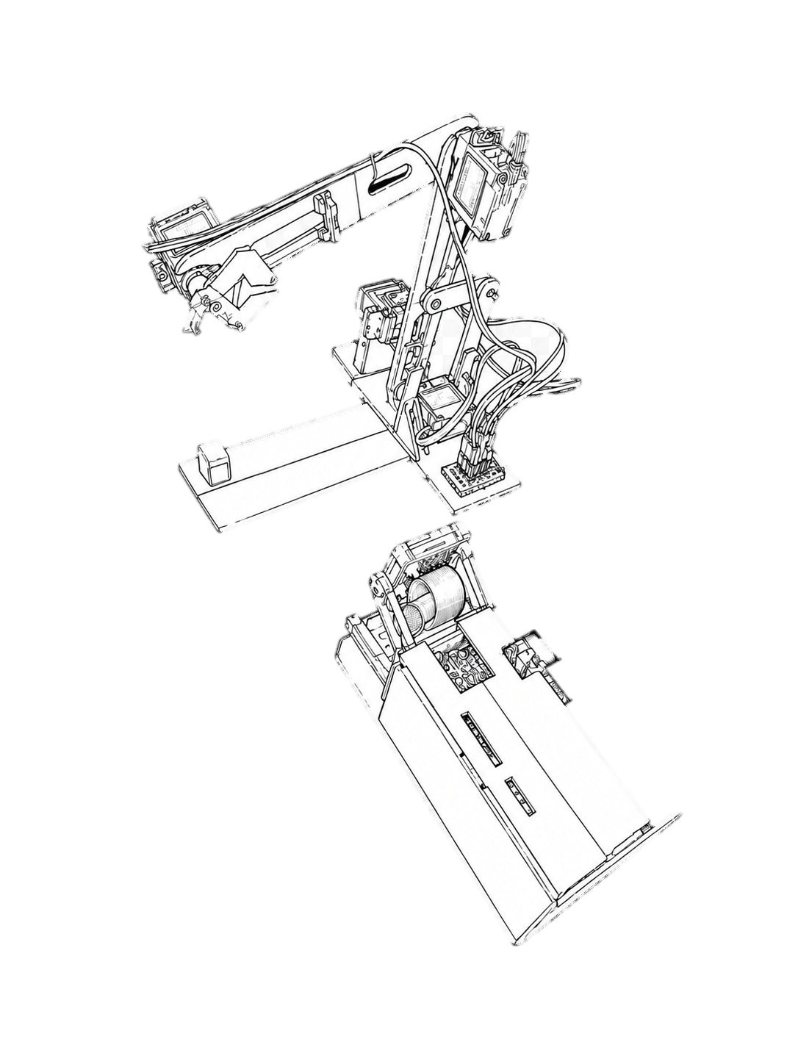
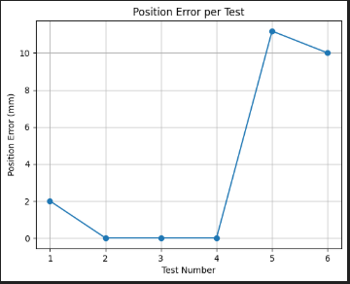
Final Structure and Results
Servos
End Efferctor
Target
Camera
Controllers

Slide 10
Conclusions:
The main issue is low precision due to the handmade structure and inexpensive servos
Position errors are typically around 5–10 mm
Despite this:
Robotic systems can be built with low-cost materials
Key industrial robotics principles can still be applied
This project provides a strong base for future work in:
Robotics
Control systems
AI-based automation

Slide 11
Thank you for your attention.

